Slide 1
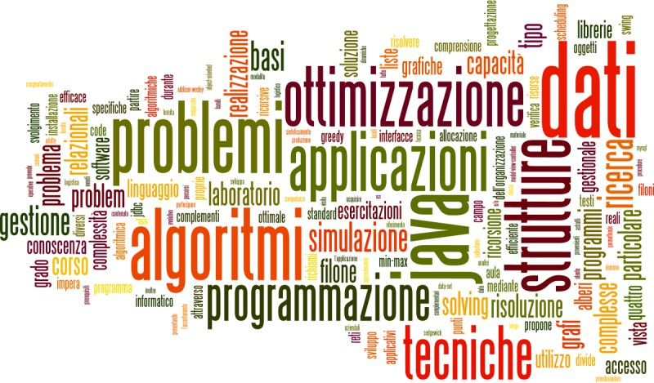
JavaFX – Tutorial
Classi quarte – Itis Leonardo da vinci PR

Slide 2
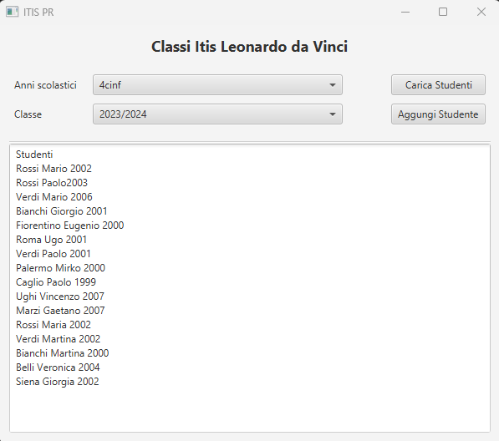
JavaFX applications

Slide 3


Application structure
🞂​ Stage: where the application will be displayed (e.g., a Windows’ window)
🞂​ Scene: one container of Nodes that compose one “page” of your application
🞂​ Node: an element in the Scene, with a visual appearance and an interactive behavior.
🞂​ Nodes may be hierarchically nested

Slide 4
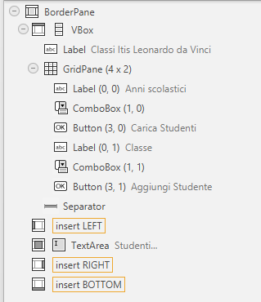
Nested nodes

Slide 5

TextInputControl
ChoiceBox
TextArea
TextField
Focus on Panes and
Nodes family
ComboBoxBase
ColorPicker
ComboBox
ListView
Controls
MenuBar
Control
Separator
Group
Slider
TabPane
Button
MenuButton
Label
Parent
ToolBar
ButtonBase
CheckBox
ToggleButton
Labeled
Cell
TitledPane
Axis
Region
Chart
AnchorPane
FlowPane
HBox
TilePane
javafx.scene.Node
WebView
Pane
BorderPane
GridPane
StackPane
VBox
Arc
Line
Polyline
Text
Shape
Circle
Polygon
Rectangle
Canvas
5
Imageview
Tecniche di programmazione
A.A. 2022/2023

Slide 6
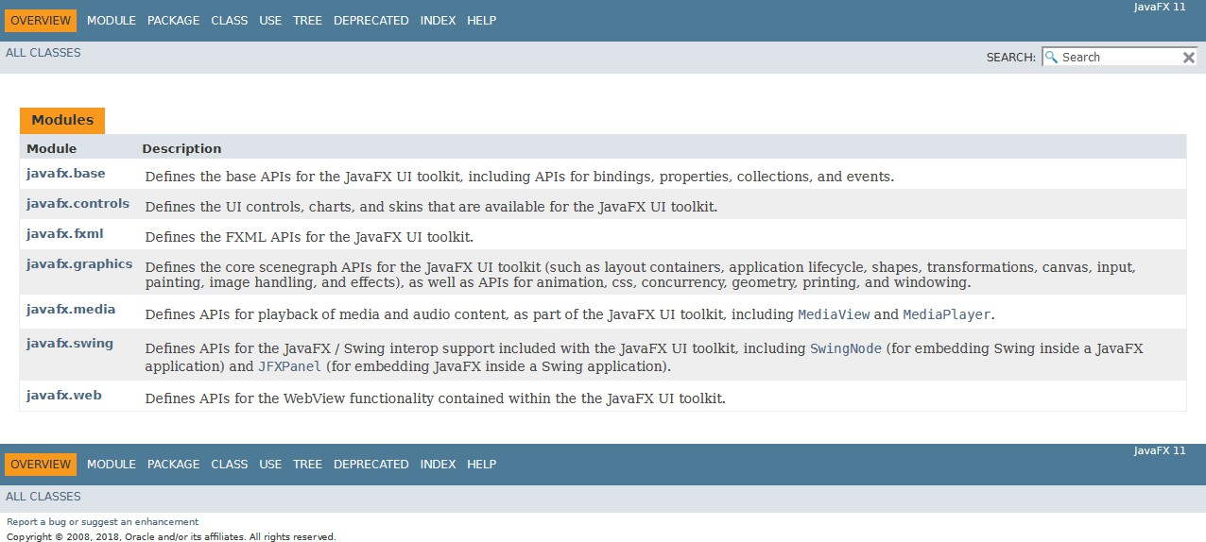
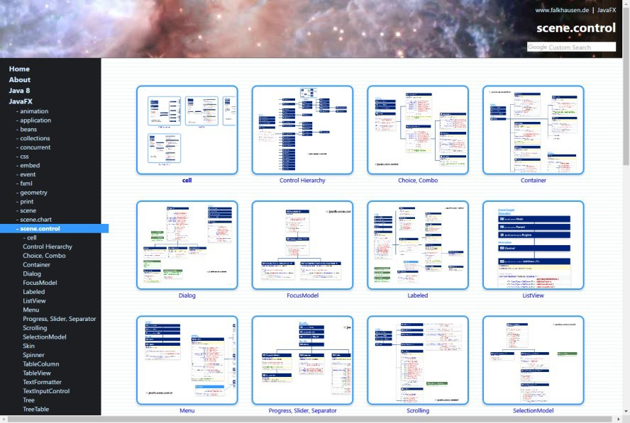
Essential Reference
🞂​ JavaFX JavaDoc API
🞂​ https://openjfx.io/javado
c/11/
🞂​ JavaFX Class Diagrams
🞂​ http://falkhausen.de/Java
FX-10/index.html

Slide 7
General rules
🞂​ A JavaFX application extends
javafx.application.Application
🞂​ The main() method should call Application.launch()
🞂​ The start() method is the main entry point for all JavaFX applications
🞂​ Called with a Stage connected to the Operating System’s
window
🞂​ The content of the scene is represented as a hierarchical scene graph of Nodes
🞂​ Stage is the top-level JavaFX container
🞂​ Scene is the container for all content

Slide 8
Nodes
🞂​ The Scene is populated with a tree of Nodes
🞂​ Layout components (Panes)
🞂​ UI Controls
🞂​ Charts
🞂​ Shapes
🞂​ Nodes have Properties
🞂​ Visual (size, position, z-order, color, ...)
🞂​ Contents (text, value, data sets, ...)
🞂​ Programming (event handlers, controller)
🞂​ Nodes generate Events
🞂​ UI events
🞂​ Nodes can be styled with CSS

Slide 9
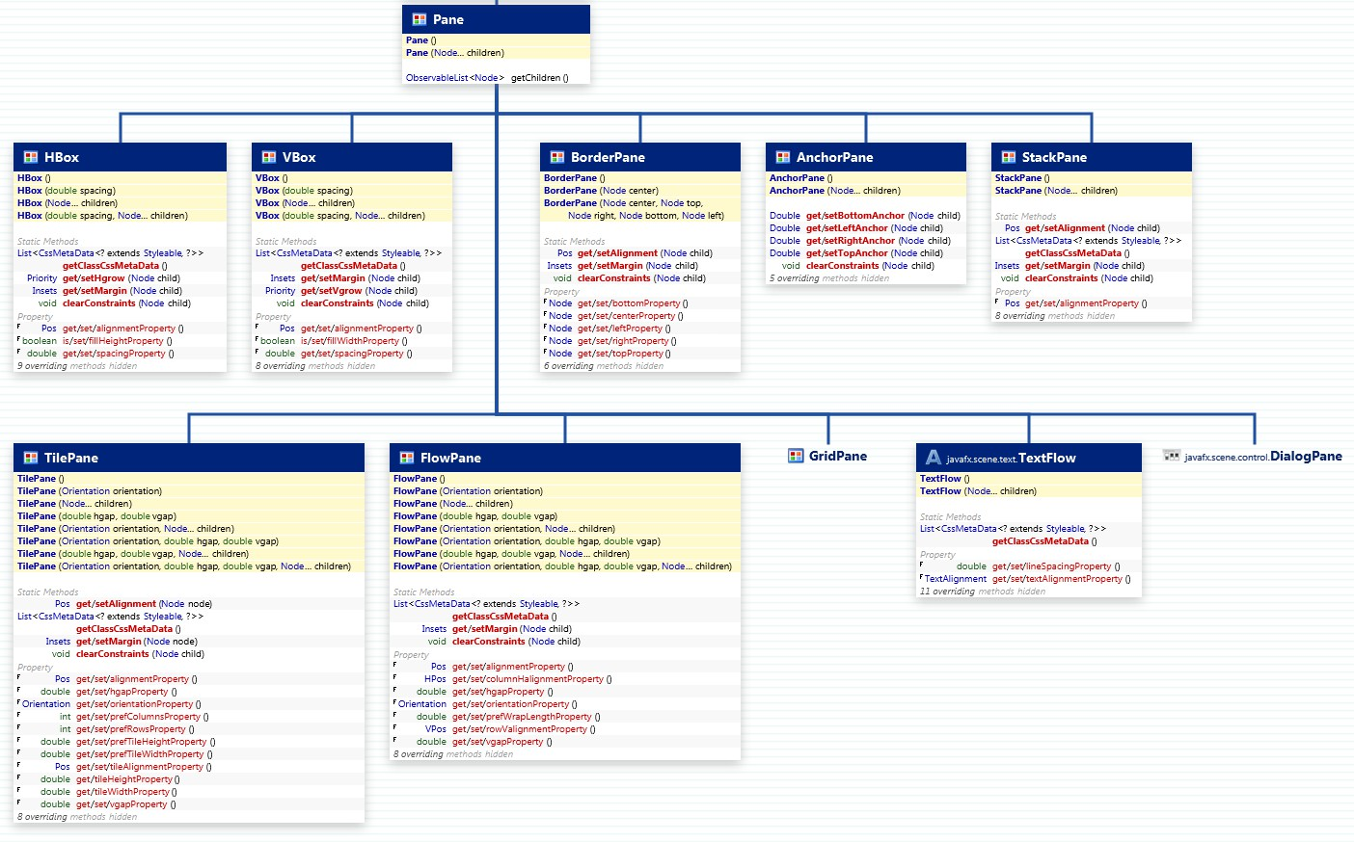
Panes
http://falkhausen.de/JavaFX-10/scene.layout/Pane.html

Slide 10
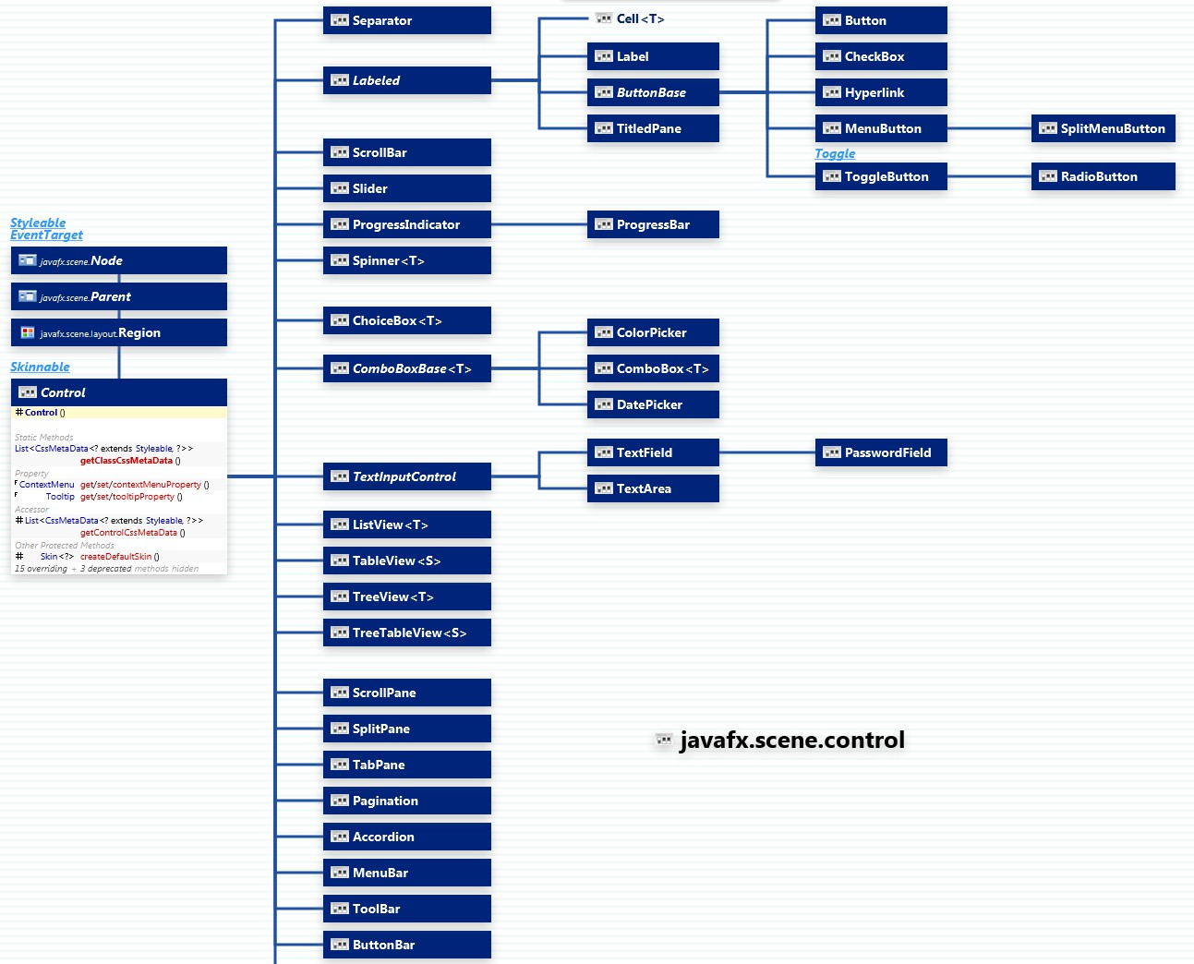
Controls
http://falkhausen.de/JavaFX-10/scene.control/Control-Hierarchy.html

Slide 11
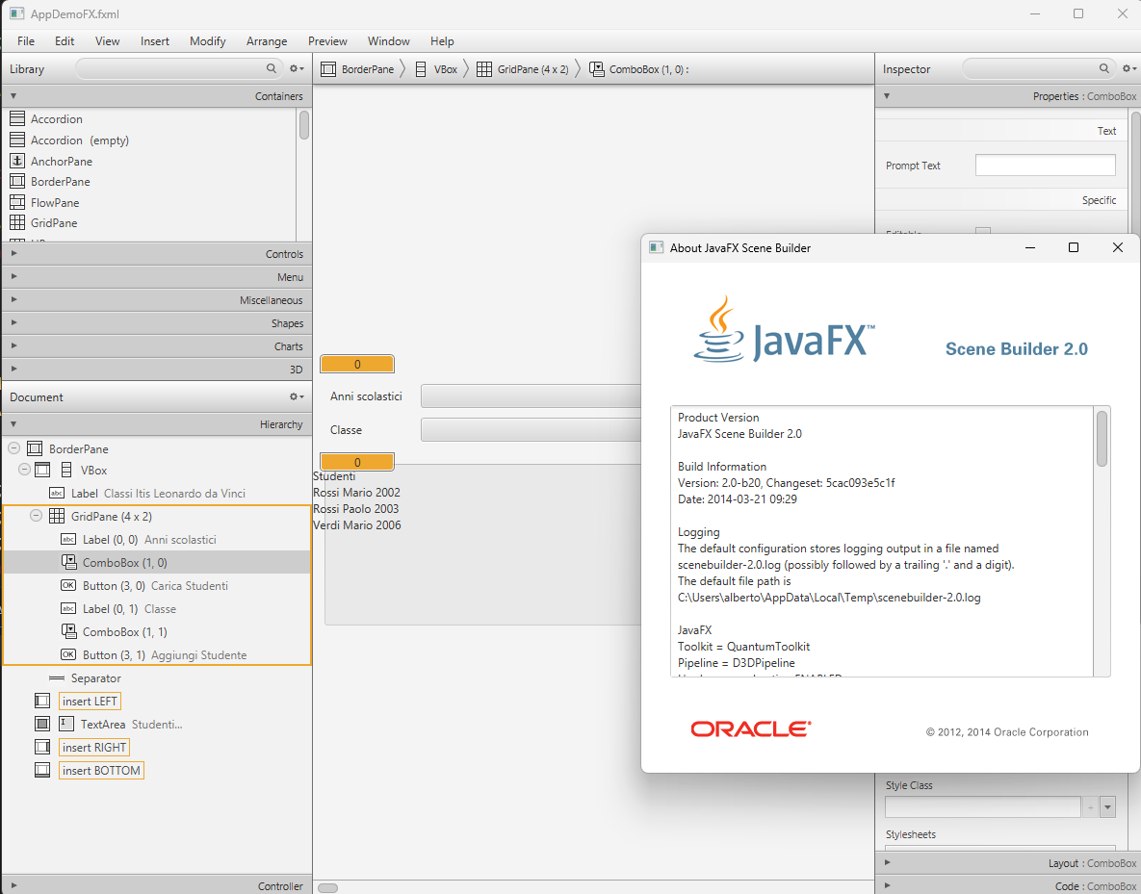
JavaFX Scene Builder 2.0 Oracle

Slide 12
Building a scene from FXML
public void start(Stage stage) throws Exception {
Parent root = FXMLLoader.load( getClass().getResource("/fxml/Scene.fxml"));
stage.setTitle("Circle Demo"); stage.setScene(new Scene(root)); stage.show();
}

Slide 13
Key concepts in JavaFX
🞂​ Property: attributes of the Nodes, may specify content,
size, color, … Can be read and written by the application
🞂​ Event: every user action on one element of the GUI generates a different event. Events can be captured and handled by our code
🞂​ Controller: the Java class that contains
🞂​ References to interesting Nodes
🞂​ Event Handlers

Slide 14
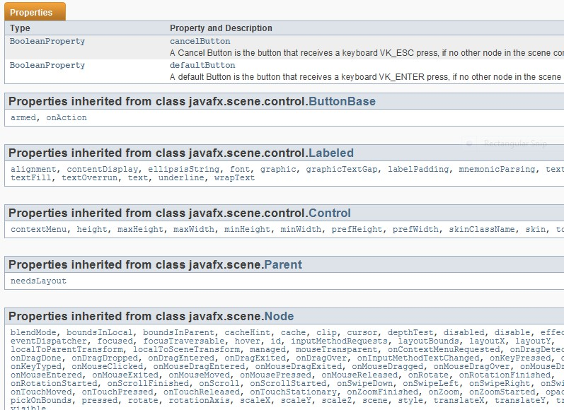
Properties
🞂​ Extension of the Java Beans convention
🞂​ May be used also outside JavaFX
🞂​ Encapsulate properties of an object
🞂​ Different types (string, number, object, collection, ...)
🞂​ Set/Get
🞂​ Observe changes
🞂​ Support lazy evaluation
🞂​ Each Node has a
large set of Properties
🞂​ Can be manipulated
🞂​ The scene updates

Slide 15
Events
🞂​ FX Event (javafx.event.Event):
🞂​ Event Source => a Node
🞂​ Event Target
🞂​ Event Type
🞂​ Usually generated after some user action
🞂​ Event Types
🞂​ You can define event handlers in your application

Slide 16
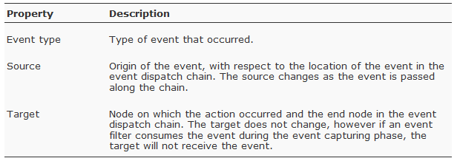
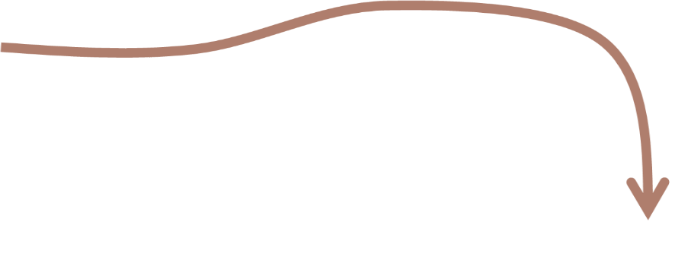
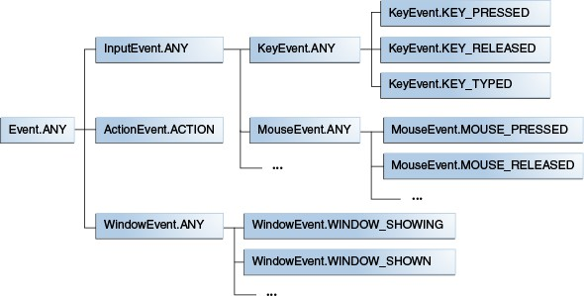
What is an event?

Slide 17
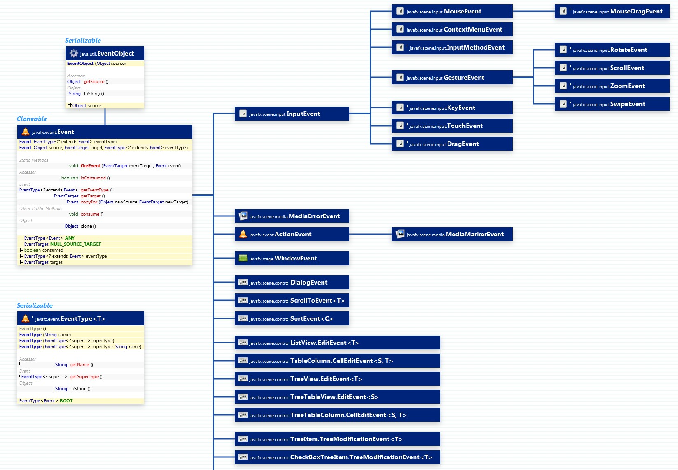
Event types
http://falkhausen.de/JavaFX-8/event/Event-Hierarchy.html

Slide 18
Defining a Controller class
🞂​ The Root element of the scene graph may specify a fx: controller attribute
🞂​ <BorderPane id="BorderPane"
xmlns:fx="http://javafx.com/fxml"
fx:controller="it.pr.itis.informatica.MioController">

Slide 19
Injection of Node references
🞂​ The controller code may directly access various Nodes in the associated scene graph
🞂​ The attribute @FXML associates a Node variable with the corresponding node, with the same fx:id value as the variable name
🞂​ Try: View | Show Sample Controller Skeleton on the Scene Builder!
@FXML // fx:id="theTitle"
private Label theTitle;

Slide 20
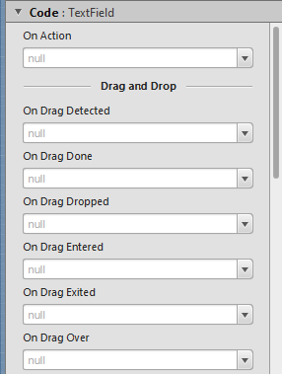
Registration of Event Handlers
🞂​ In FXML, you may set a event handler through attributes
🞂​ onAction, onKeyTyped, onMouseClicked, ... hundreds more ...
🞂​ The value should be the #name of a method in the controller class
🞂​ With the right signature for the event type
<Button fx:id="cercaBtn" onAction="#doCercaParola" text="Cerca" />
@FXML
void doCercaParola ( ActionEvent event ) {

Slide 21

Minimal program structure
« View »
FXML file
Nodes (layout + controls)
Main (load & launch)
event handlers
node properties
« Controller »
« Model » Algorithms & Data Structures

